Slide 1
By: Mohamed Hammouda
Student ID: 23077543
Horizon Travel (WDAD)

Slide 2
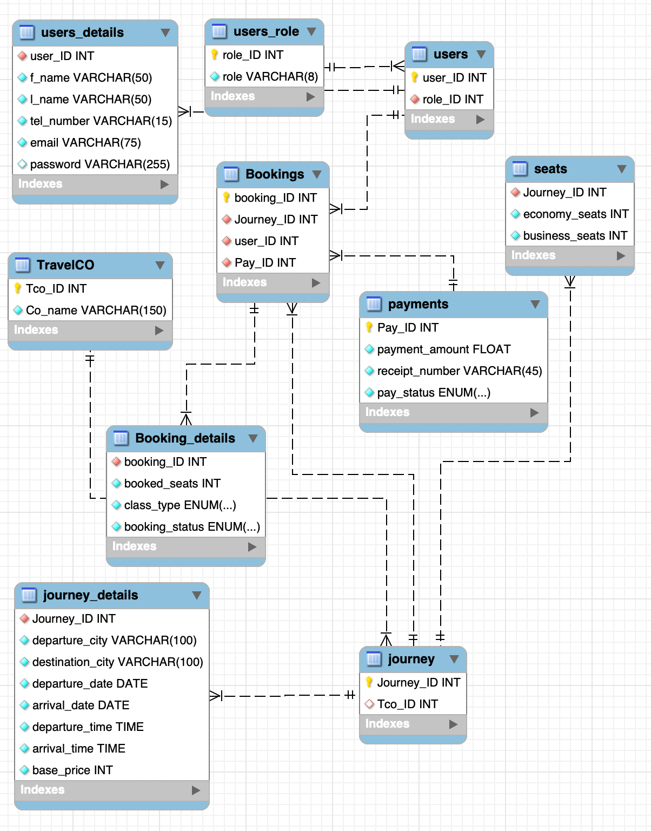
Database design
First Normal Form (1NF)
Each column stores atomic (indivisible) values for clarity, and every table has a primary key to uniquely identify records, ensuring data integrity and efficient relationships.
Second Normal Form (2NF)
the table structure already conforms to (1NF), which means it contains only atomic values with no repeating groups, and- Non-key column depends on entire primary key.
Third Normal Form (3NF)
The database design adheres to 2NF, ensuring all non-key attributes fully depend on the primary key. It eliminates transitive dependencies which no non-key attribute depends on another.

Slide 3
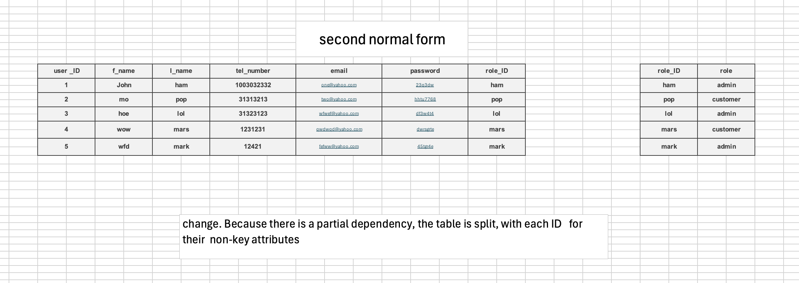
Conceptual model

Slide 4

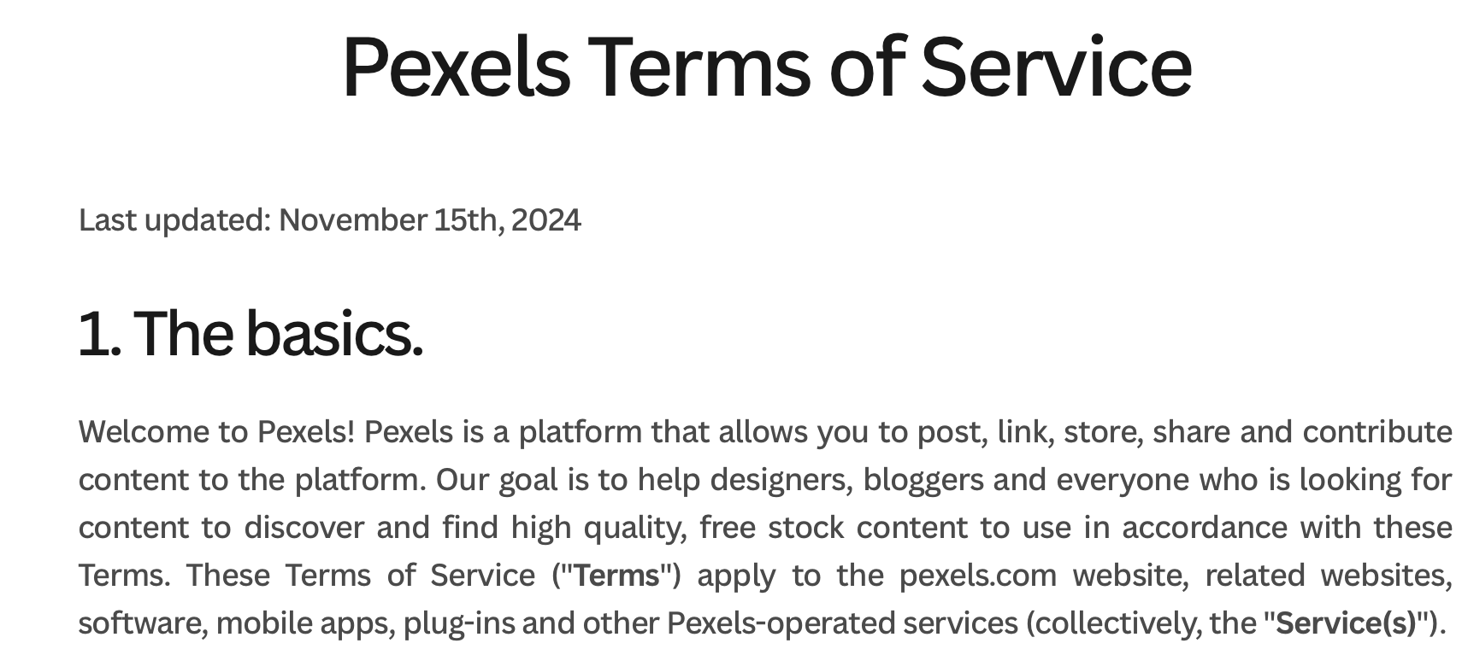
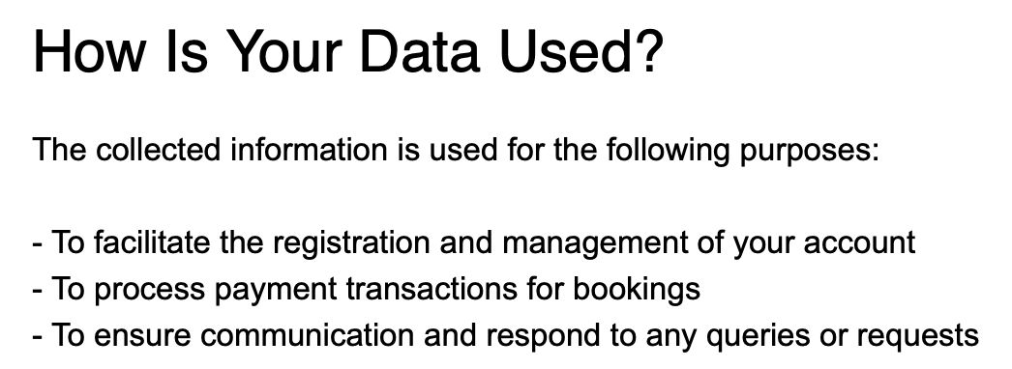
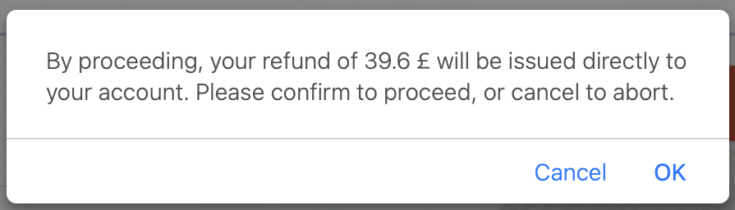
LESP
Legal : Background images are sourced from Pexels under a royalty-free license, while logos, interface designs, and branding elements are proprietary intellectual property. Source: https://www.pexels.com/license
Ethical: The website must display cancellation fees before user confirmation and provide a clear legal notice in the "About Us" section outlining cancellation policies and data handling practices to ensure transparency and compliance.

Slide 5
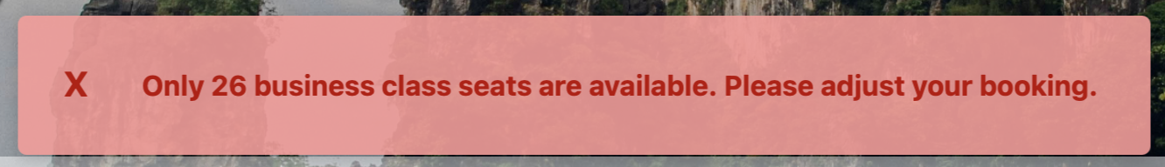
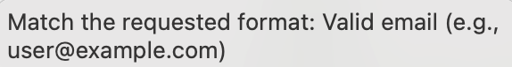
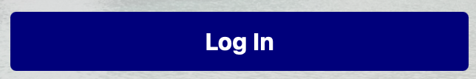
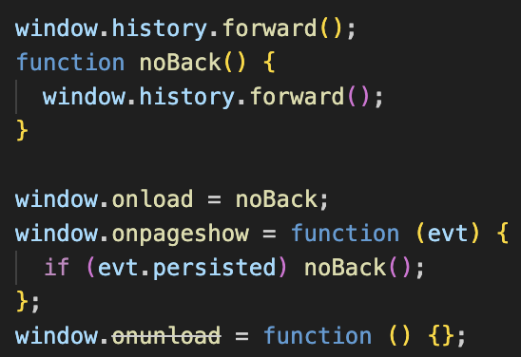
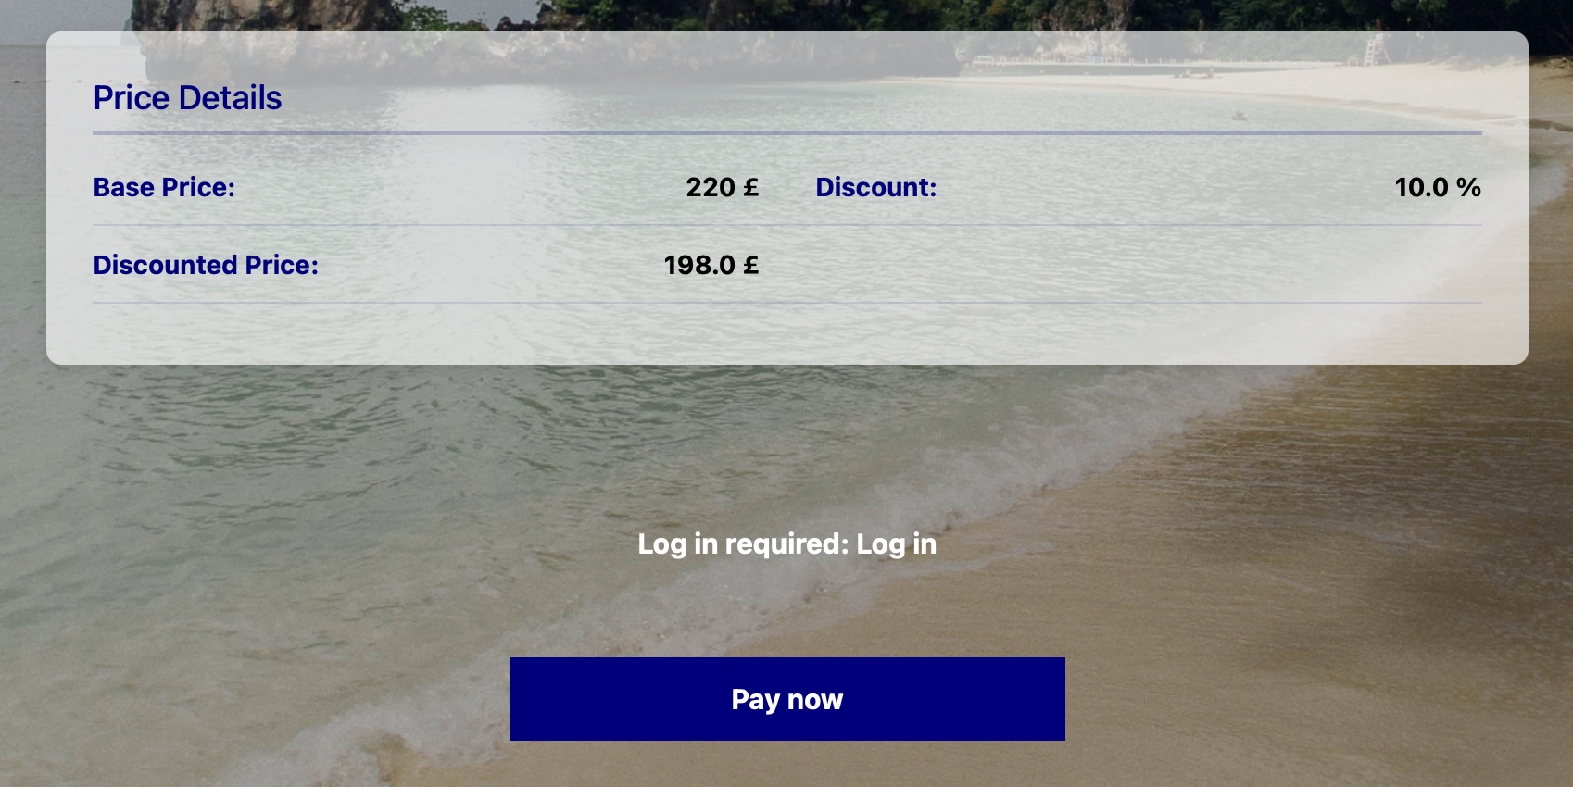
LESP
Social: The system must prioritize accessibility by incorporating high-contrast modes , simplified language, and WCAG 2.1-compliant error alerts to support users.
Professional: Users Users enjoy frictionless flight searches without login, with account requirements only at checkout. Meanwhile, LESP-compliant safeguards (back-button blocking, token checks) protect payment flows from duplicates or exploits—ensuring speed, security, and scalability.

Slide 6
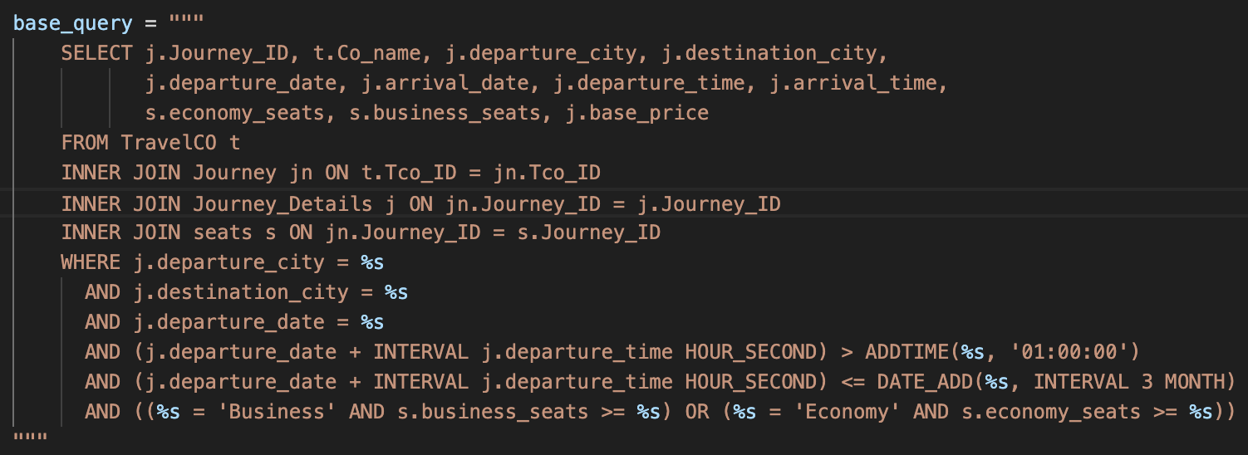
Security
Salted Hashing by Default – Bcrypt automatically generates and applies a unique salt for each password, preventing rainbow table attacks where hackers use precomputed hashes to crack passwords which bycrypt cannot unhashed
Prevents SQL Injection : Instead of directly embedding user input into the query (which would be dangerous), %s acts as a placeholder that will be safely replaced with properly escaped values when the query executes. This is essential for protecting against SQL injection attacks, where malicious users could manipulate queries to access unauthorized data.
1- Session Validation – Verify that the user has a valid, authenticated session with admin privileges before granting access.
2- Referer Header Check – Ensure the request originates from an approved page rather than direct URL entry.

Slide 7
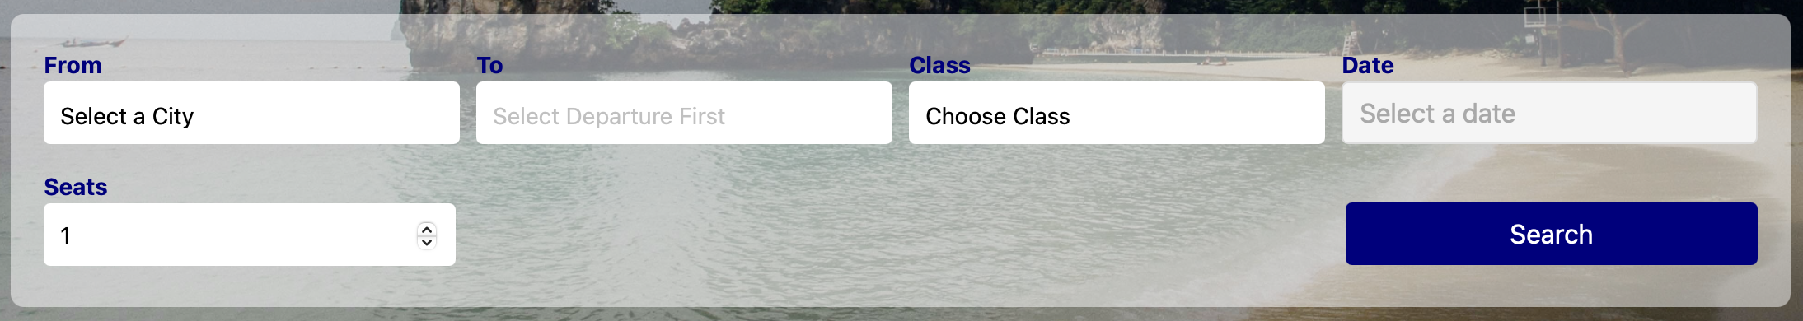


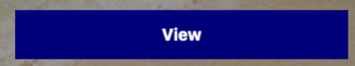
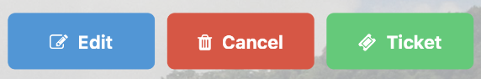
Responsive web design
Custom Media Queries for Adaptive Layouts: The website design was with manual media queries for finer control and Bootstrap’s default exist. On desktop, forms and buttons remain horizontal, while on mobile, they shift to a stacked layout—adjusting spacing, text size, and element compression for optimal display.
Hamburger Menu for Mobile Navigation: To enhance mobile usability, the navigation collapses into a toggleable hamburger menu, reducing clutter while preserving full functionality. This ensures a seamless experience across all device sizes.
Responsive Component Adjustments: UI elements adapt dynamically: buttons resize for touch targets, forms switch between inline (desktop) and stacked (mobile), and text scales to prevent overflow. These targeted changes guarantee consistency and usability at every breakpoint.

Slide 8
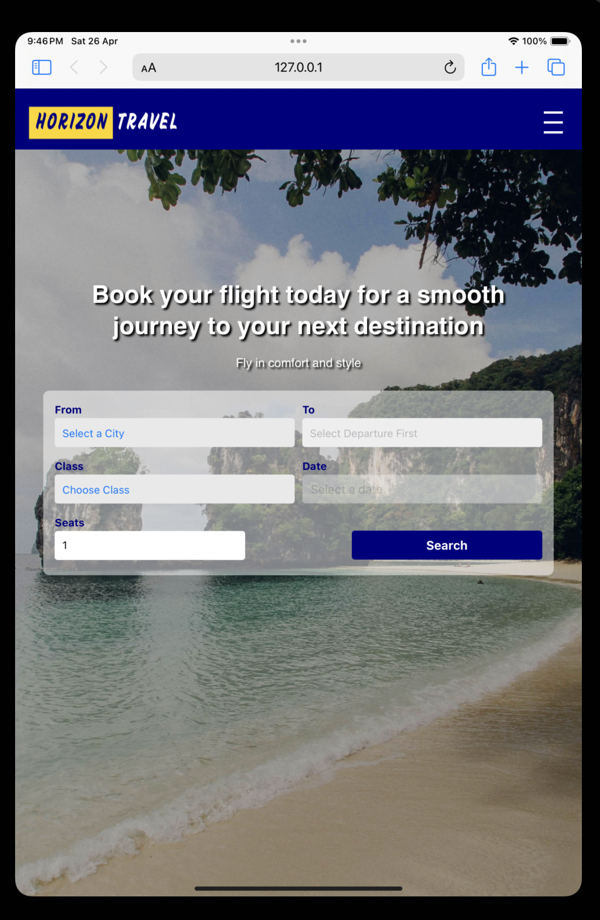
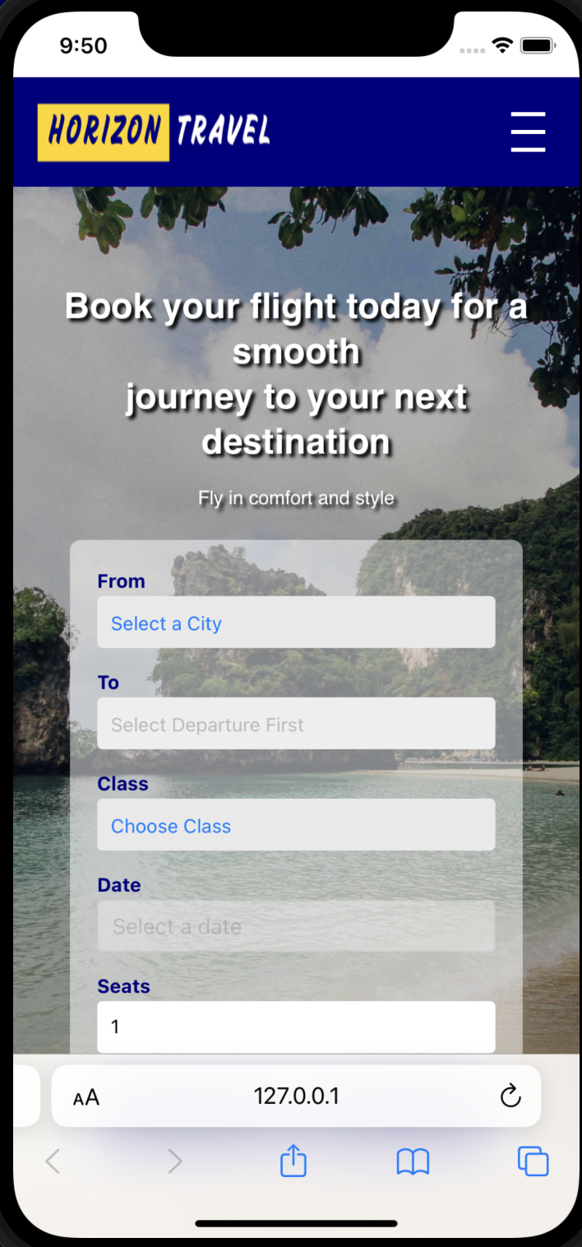
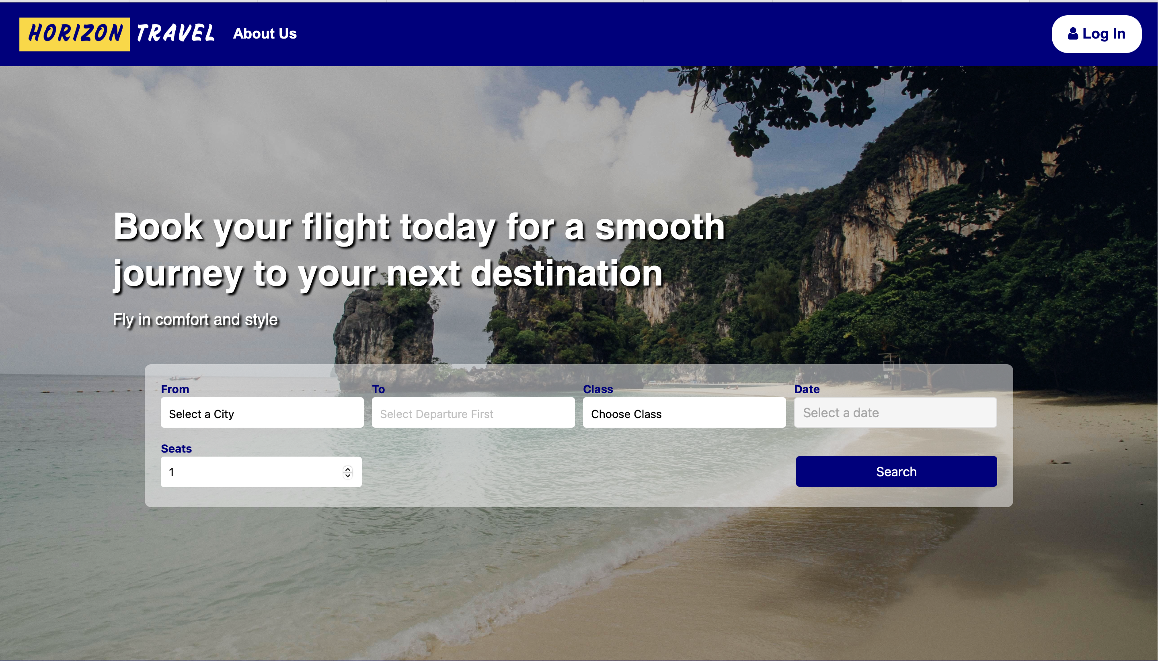
Differen screen sizes
Ipad mini 6th generation
Macbook Air 13.3 inches
Iphone 11

Slide 9
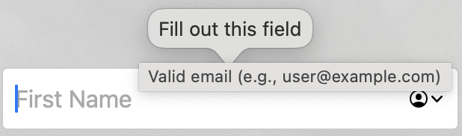
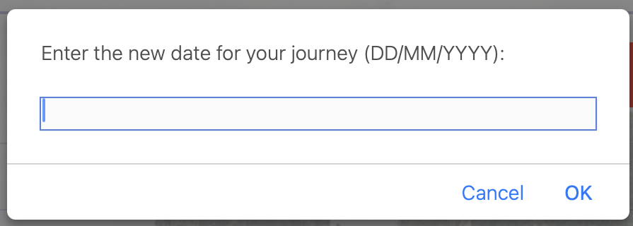
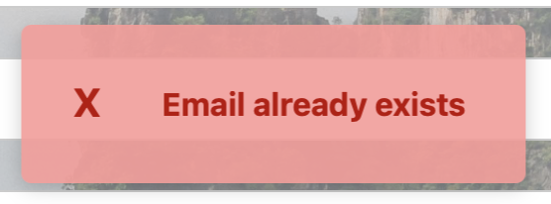
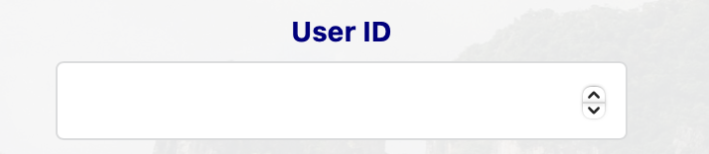
validation
Test | Input | Expected Result | Actual Result
Forms | Blank fields | Prompt user to enter a value | Behaviour as expected
update Booking | Update date | Found match journey or not | Behaviour as expected
Unique details | Sign up with a previously used email | Display message | As expected
Admin Functionality | Search for journey, user, booking, or report | Display relevant details based on search | Worked as expected

Slide 10
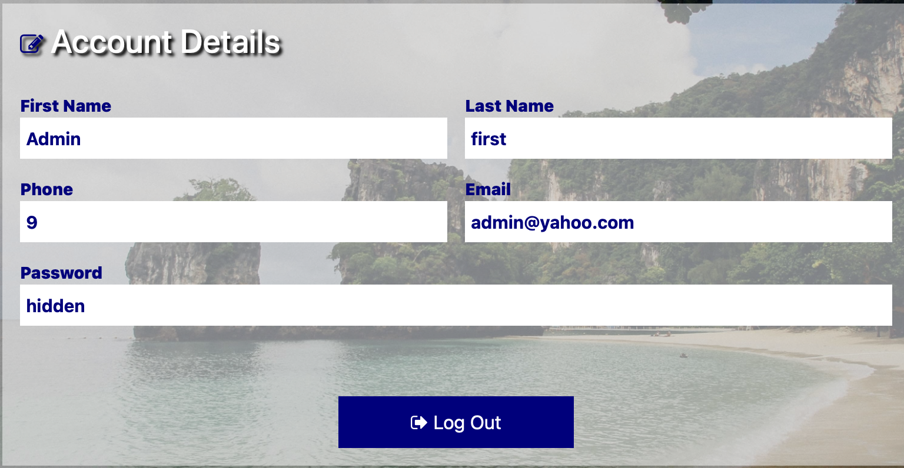
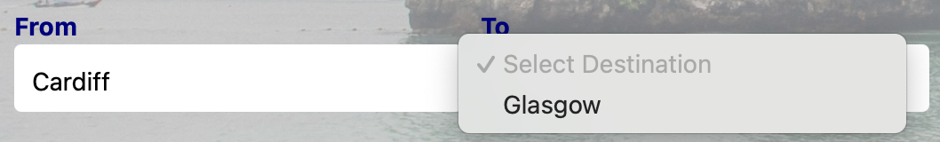
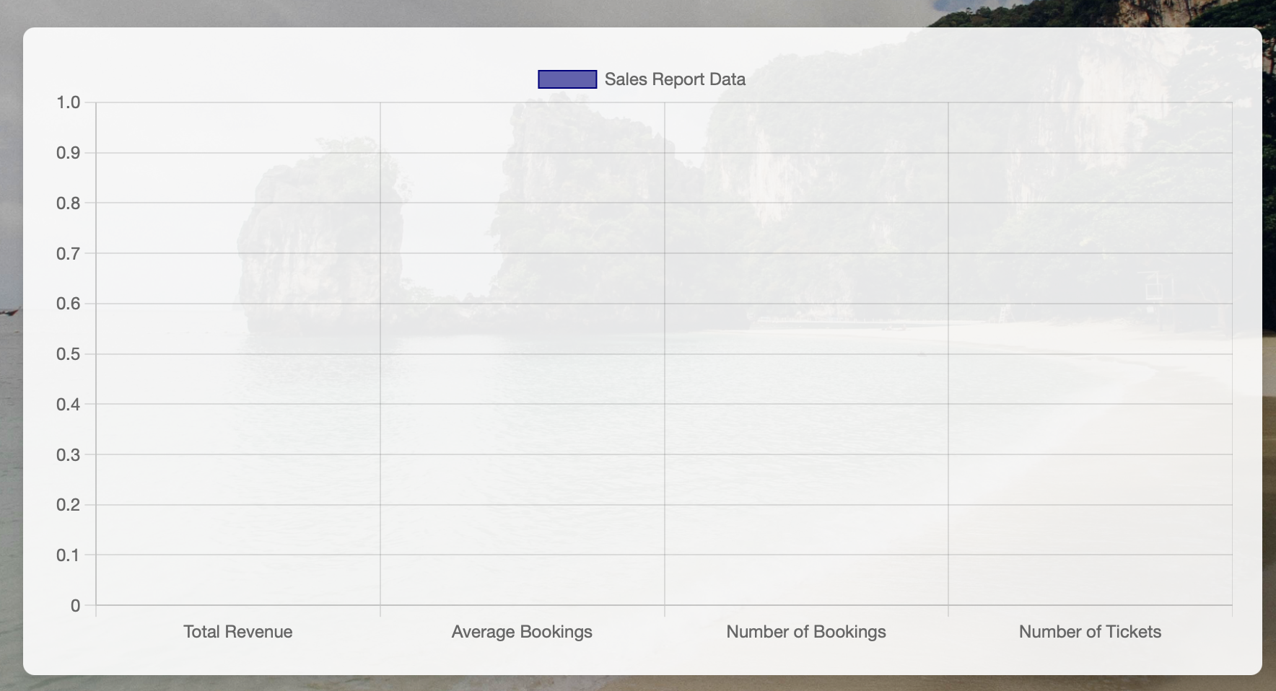
Unique features
User Account Management Users can update passwords and personal details (name, email, contact info). The system validates data for format (e.g., proper email) and uniqueness (no duplicate usernames/emails).
Admin Data Visualization Admins can view data in tables and graphs (bar, pie, trend lines) to analyze bookings, revenue, and seat occupancy by travel class.
Journey Display Logic Only routes with available seats (any class) are shown. Date filters refine results to matching routes. Routes with zero seats or invalid routes are hidden.

